Slide 1




PDS
Data Centers
Computer Vision
https://github.com/siagianp
https://www.youtube.com/@AmelOline/videos
https://github.com/amelcharolinesgn2/Cloud-Infrastructures
https://github.com/amelcharolinesgn2/ClouD-Infrastructure-SISKA-2025
https://github.com/amelcharolinesgn2/CCNA1
https://github.com/amelcharolinesgn2/CCNA2
https://github.com/amelcharolinesgn2/AWS Certificate
Notes:
Lab Session 01: AWS Compute Foundations – EC2, Networking, and Application Deployment Lab Session 02: Identity and Access Control with IAM Lab Session 03: Cloud Storage Solutions – S3, EBS, and EFS Lab Session 04: Database Services – RDS, DynamoDB, and ElastiCache Lab Session 05: Load Balancing and Auto Scaling Lab Session 06: Container Orchestration with ECS, Fargate, and EKS Lab Session 07: Serverless Computing with Lambda Lab Session 08: Monitoring, Logging, and Security Auditing Lab Session 09: Infrastructure as Code – CloudFormation, CDK, and Terraform Lab Session 10: CI/CD Pipelines – App Runner, CodePipeline, GitHub Actions, and CodeDeploy Lab Session 11: AI/ML Services – Rekognition, Comprehend, Translate, and SageMaker Lab Session 12: Hybrid Cloud Networking – VPC Peering, Transit Gateway, VPN, and Direct Connect Lab Session 13: Security and Compliance – AWS Config, GuardDuty, Security Hub, and KMS Lab Session 14: Disaster Recovery and Business Continuity – AWS Backup, Multi-Region, and Failover Lab Session 15: Migration and Modernization – DataSync, DMS, MGN, Containers, and Serverless
Lab Session 16: Cost Management and Optimization – Cost Explorer, Trusted Advisor, Budgets, and Well-Architected
https://www.youtube.com/watch?v=SOTamWNgDKc&t=19604s

Slide 2
Data Centers
Design, Architecture, and Tier Levels

Slide 3
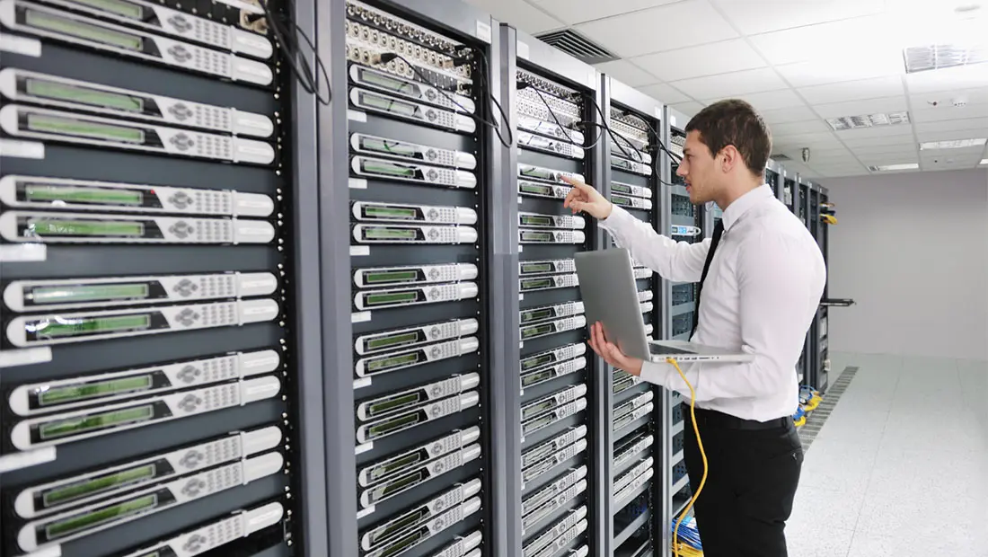

Slide 4
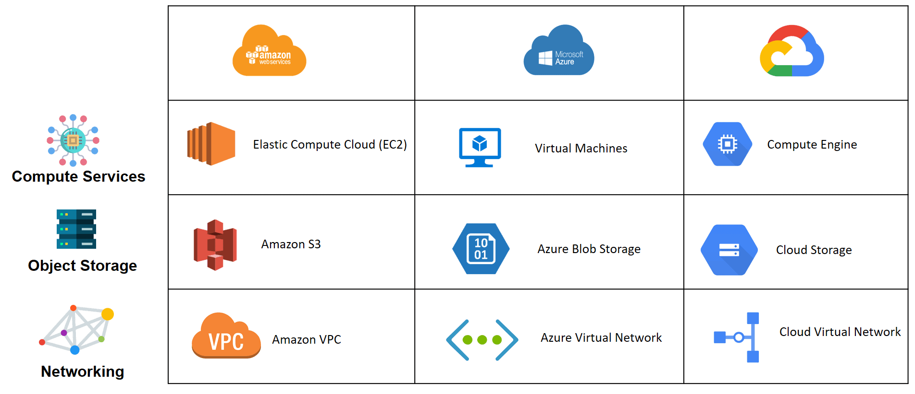

Slide 5
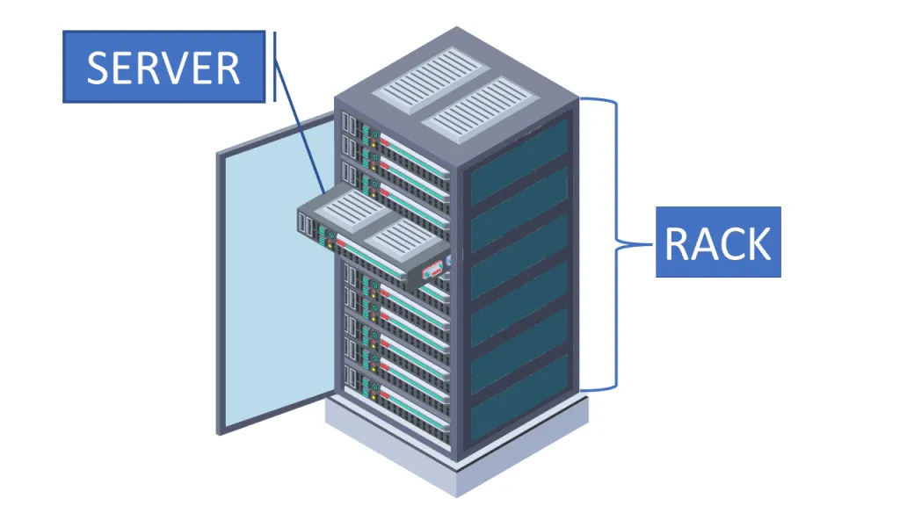
Data Centers
Data Center: A data center is a facility used to house computer systems and associated components, such as telecommunications and storage systems.
Purpose:
Centralized management of IT resources
Support for critical applications
High availability and redundancy

Slide 6
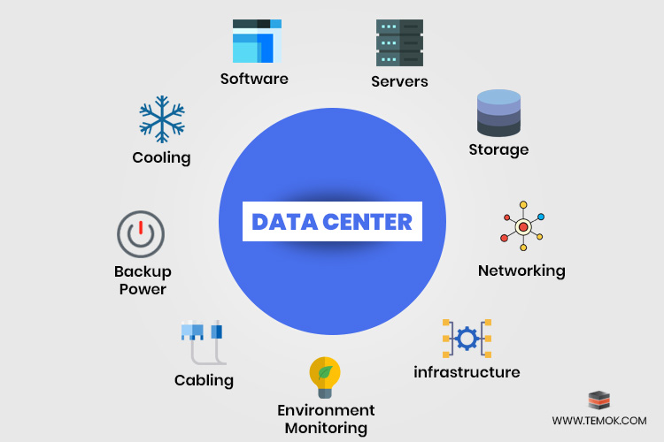
Key Components:
Key Components:
Servers
Storage Systems
Networking Equipment
Cooling Systems
Power Supply Units
Security Systems
Interdependence: Efficient operation relies on seamless integration of these components.

Slide 7
Data Center Design Principles
Scalability: Design for future growth.
Redundancy: Minimize single points of failure.
Efficiency: Optimize power and cooling.
Security: Physical and virtual protection.
Sustainability: Eco-friendly solutions.

Slide 8
Data Center Architecture
Layers:
Physical Layer: Hardware and infrastructure
Virtual Layer: Virtualized servers and networks
Application Layer: Software and services
Topology:
Star
Mesh
Leaf-Spine

Slide 9
Power Efficiency in Data Centers
Key Metrics:
PUE (Power Usage Effectiveness): Ratio of total facility energy to IT equipment energy.
DCiE (Data Center Infrastructure Efficiency): Inverse of PUE.
Techniques to Improve Efficiency:
Energy-efficient hardware
Liquid cooling systems
Renewable energy sources

Slide 10
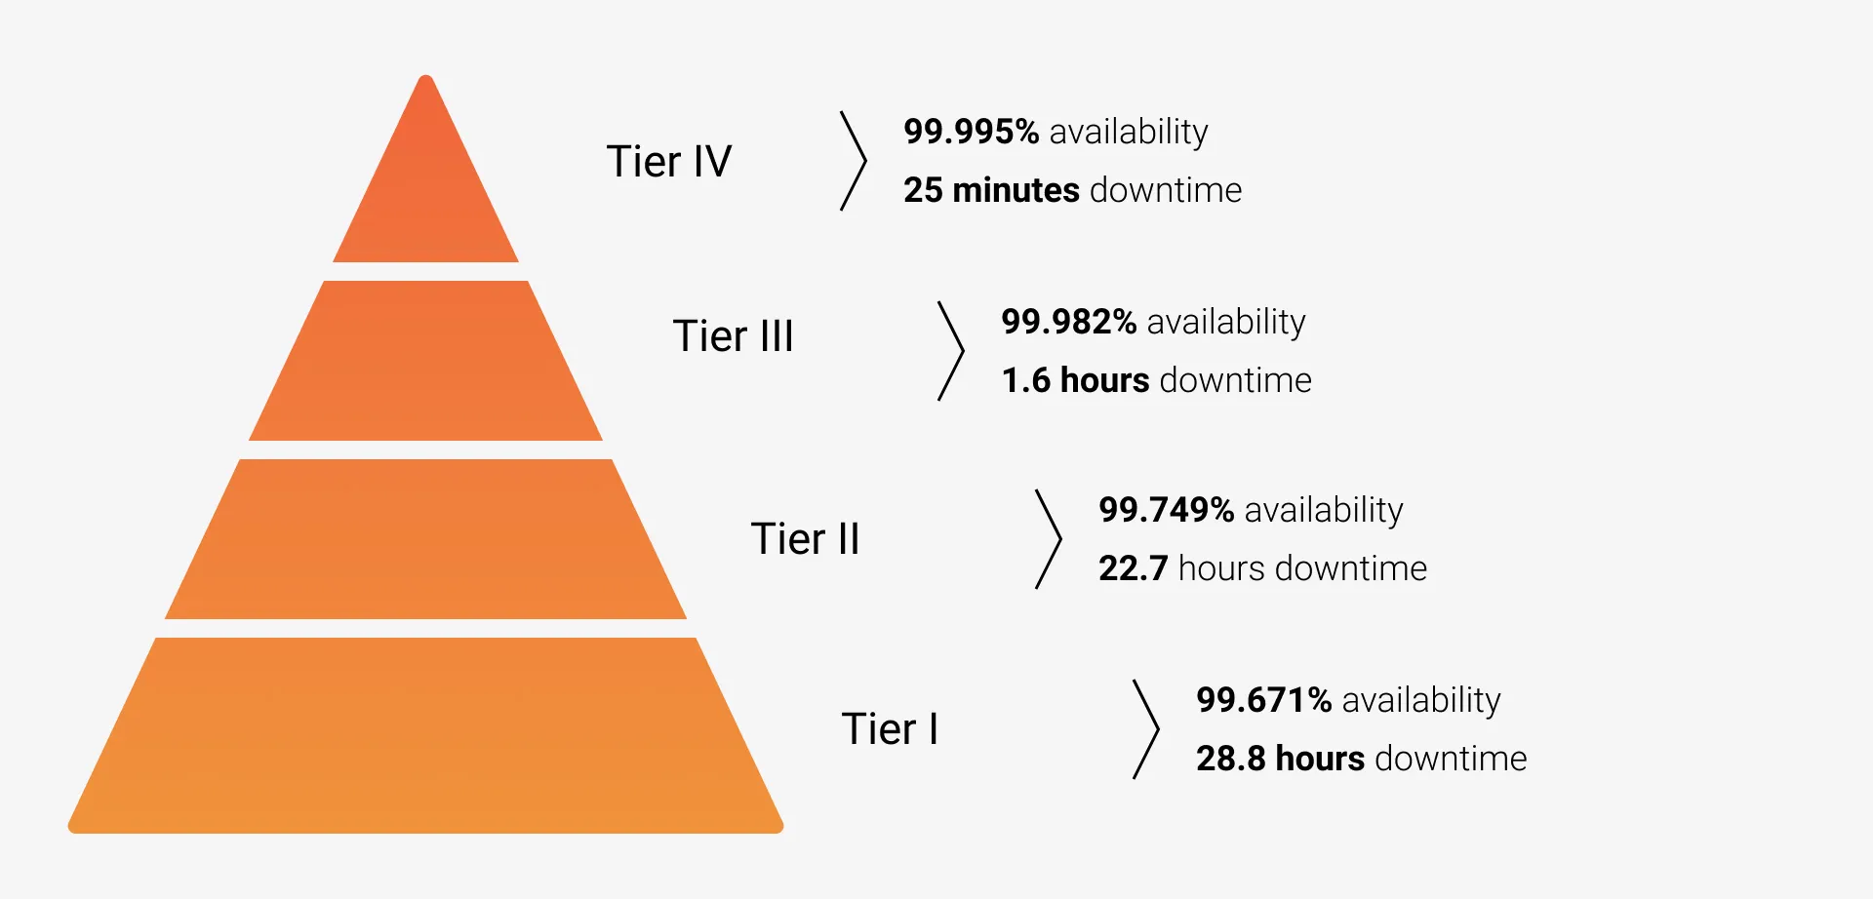
Tier Levels of Data Centers
Classification system based on uptime and redundancy.
Tiers:
Tier I: Basic Capacity (No redundancy)
Tier II: Redundant Capacity
Tier III: Concurrently Maintainable
Tier IV: Fault-Tolerant (Fully redundant systems)

Slide 11
Data Center Security
Aspects:
Physical Security: CCTV, access control
Cybersecurity: Firewalls, encryption
Disaster Recovery: Backup and replication
Importance: Protect data integrity and availability.

Slide 12
Sustainability in Data Centers
Challenges: High energy consumption.
Solutions:
Use of renewable energy.
Efficient cooling systems.
Green certifications (LEED, Energy Star).

Slide 13
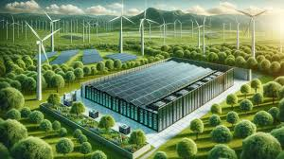
Case Study: Efficient Data Center Design
Google’s Data Centers
Techniques: AI-based cooling, renewable energy use.
Outcome: Significant energy savings.

Slide 14
Summary
Data centers are critical for modern IT infrastructure.
Design and efficiency directly impact performance and sustainability.
Understanding tier levels helps in planning for required uptime and redundancy.

Slide 15
THANK YOU
Amel charoline
Amel Online & Irene magdalena
https://github.com/siagianp
https://www.youtube.com/@AmelOline/videos
https://github.com/amelcharolinesgn2/Cloud-Infrastructures
https://github.com/amelcharolinesgn2/ClouD-Infrastructure-SISKA-2025
https://github.com/amelcharolinesgn2/CCNA1
https://github.com/amelcharolinesgn2/CCNA2
https://github.com/amelcharolinesgn2/AWS Certificate

